Slide 1
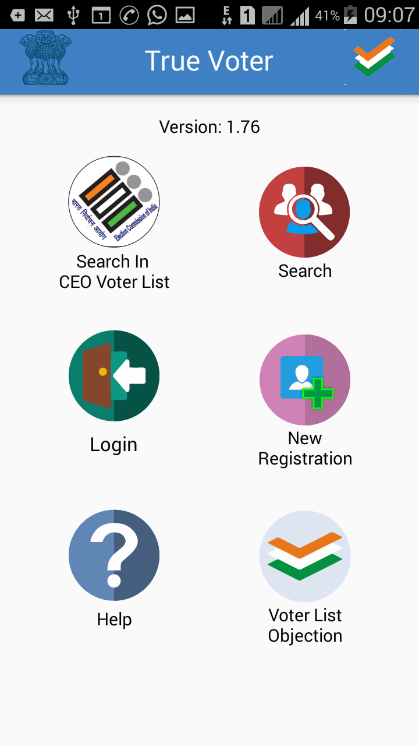
True Voter version 1.76
Download True Voter App from Play Store and Open it in your mobile.
This is the first basic home screen of the app
1. Search in CEO Voter List : This is to search your name on CEO Site through app. Follow the steps given in it for District wise and name wise search
2. SEC Search : It is used to search your name in SEC voter list as per going on Current Local Body Elections only.
3. Login : It is to be used when u register as a True Voter, Officer or as a Candidate
4. New Registration : It is to be used one time only when u have to register your self either as a Voter/ Officer/ Candidate
5. Help : FAQ, user manual, Videos are given to understand use of True Voter app
6. Voter List Objection : It is used to take objection on draft Voter List before election

Slide 2
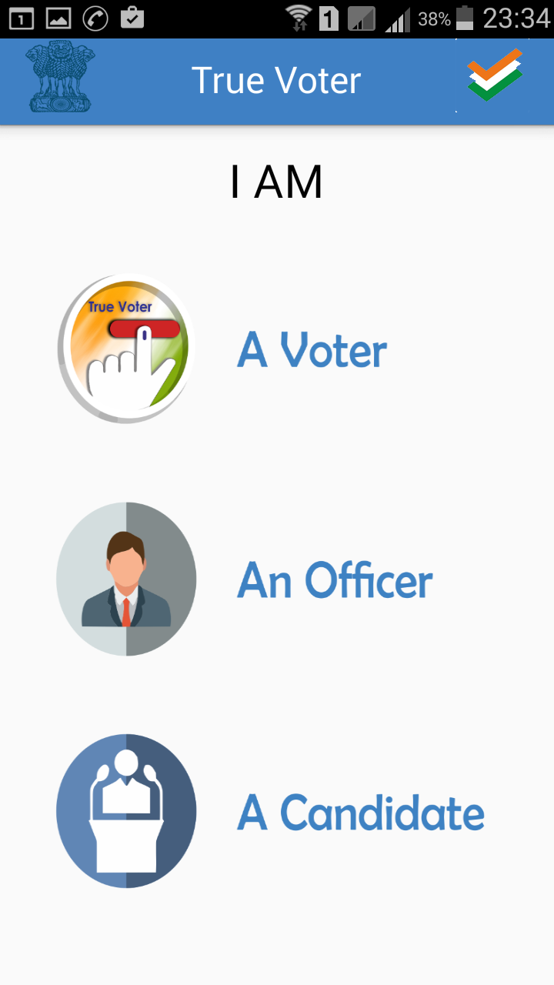
True Voter version 1.76
Every one is having a right to use True Voter app
He can use it in three Different Roles as per his requirements
1. A s A Voter : Any person having his name in Maharashtra State Election Commission List can register as a True Voter for many personal and general purpose.
2. As An Officer : All officials involved in Maharashtra State Election Program through out the state in various roles have to register as “An Officer”
3. As A Contesting Candidate and His Representative : All Contesting Candidates of the currently going on election has to register to fill their daily election expenses and their representative can also optionally use it.

Slide 3
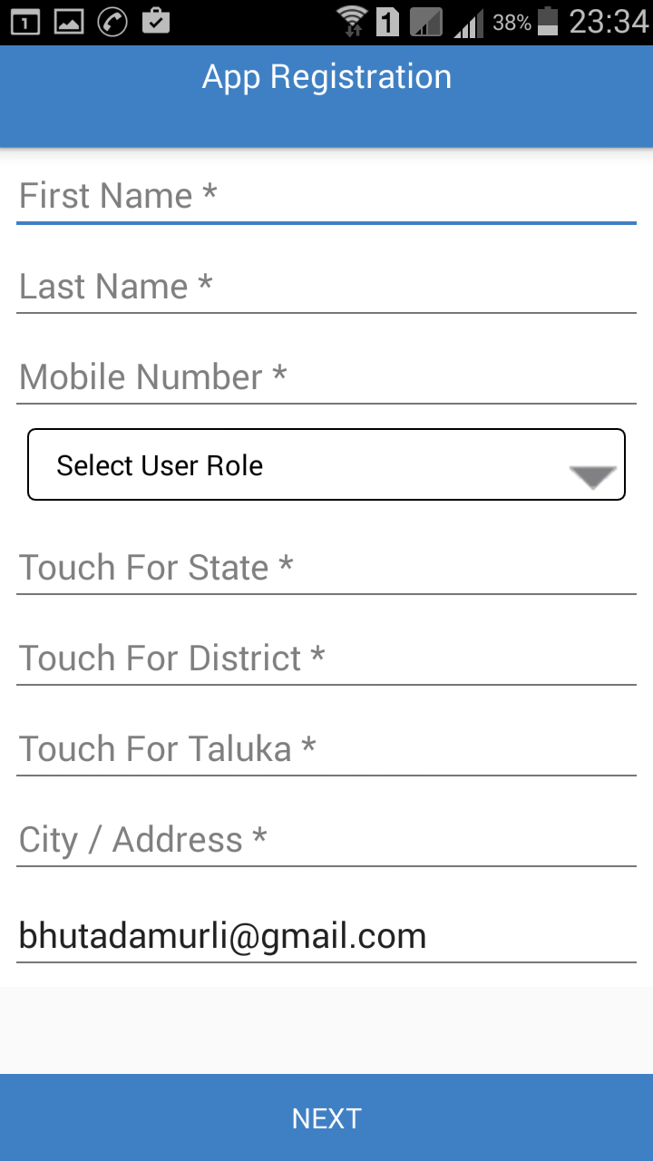
True Voter version 1.76
True Voter App registration is only required for Officers and Candidates with their representatives also if required.
Its must to fill some basic information with your mobile no, which will be verified further by OTP. So use your proper mobile no in registration.
Touch at every field to fill relevant information.
Select either Officer/Candidate role as per your work
You have to just touch to select State from the list, Touch to Select District as well as touch to select your Taluka from the given list.
Type your proper address with City/Town/Area name in “City/Address” field.
By default your email id will be picked up from ur mobile play store, correct it if required.

Slide 4
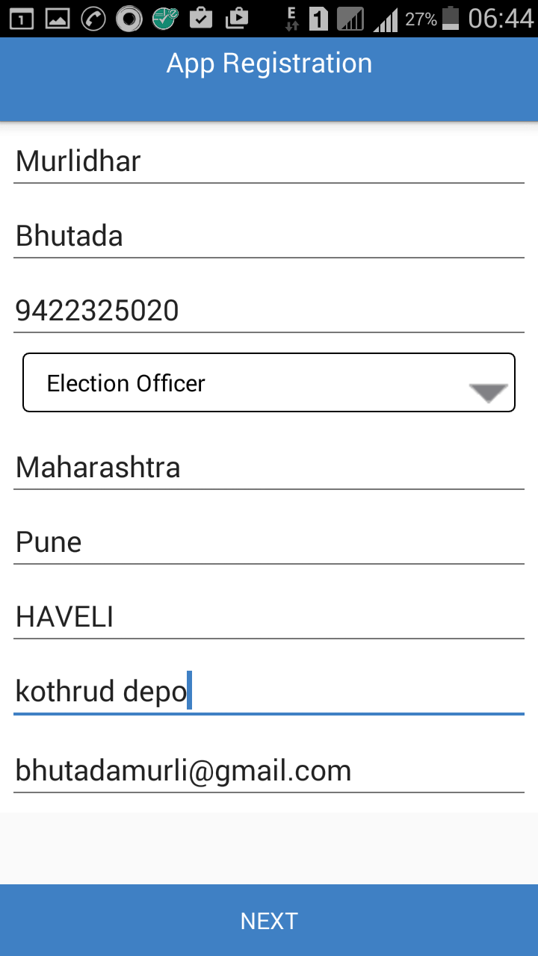
True Voter version 1.76
Sample of complete app registration is given herewith in a Election Officer role.
Use your own 10 digit mobile no properly to get verified further by OTP.
Continue on next page of registration by clicking on “NEXT” button.

Slide 5
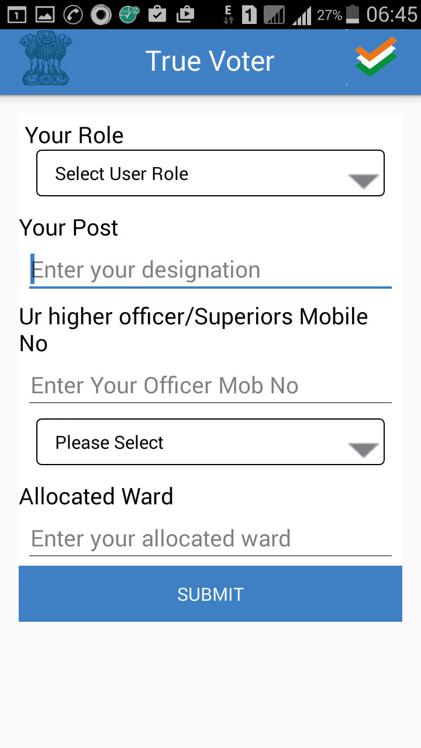
True Voter version 1.76
This is the second page of app registration. Here you have to specify your exact working role of using this app.
This app can be used when you are going to take part in various officer/staff role for any Local body election.
In “Your Post” field give your actual regular official post as u are working.
Only “Nodal Officer” looking after the election should write as “Nodal Officer”.
Properly give your just higher superior’s mobile no under whom you are working to built officer’s hierarchy tree.

Slide 6
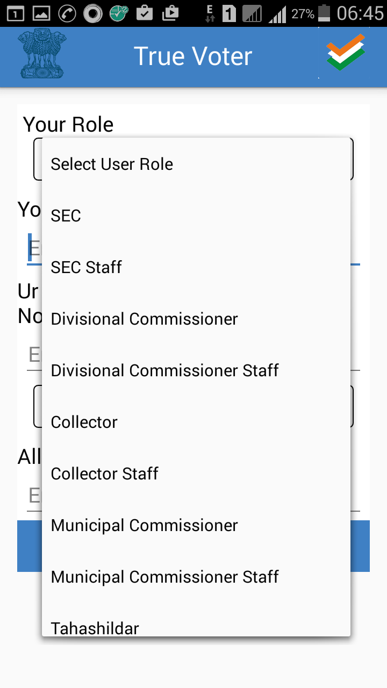
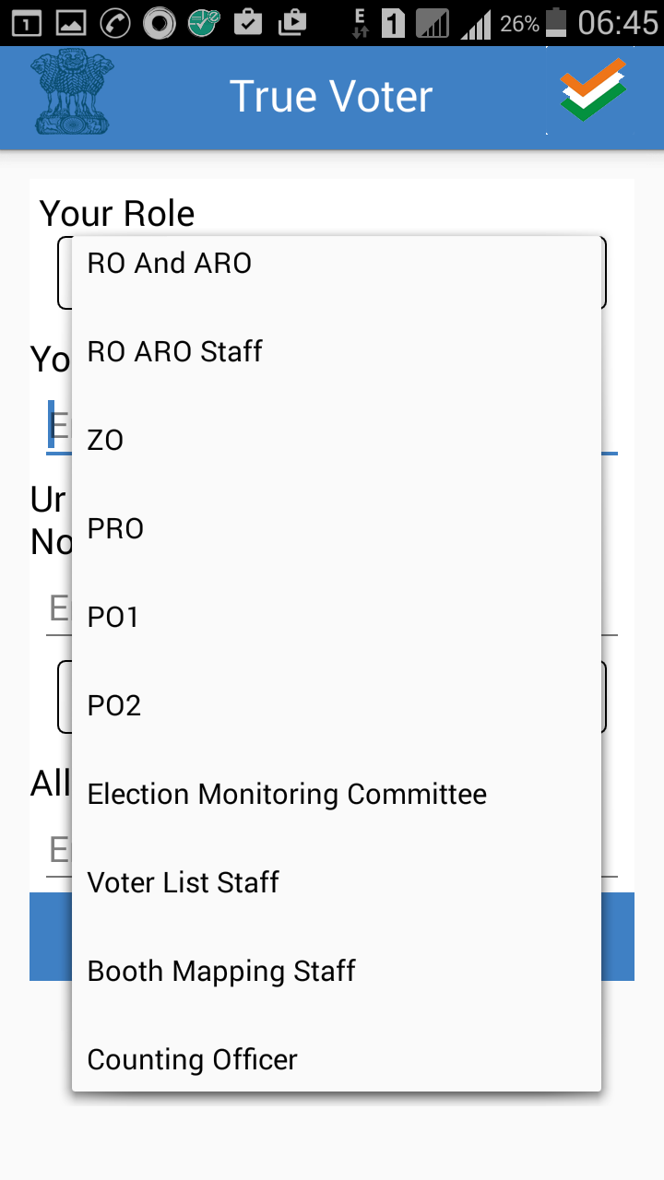
True Voter version 1.76
Select Proper Role in which you have to use this app.
There are 22 roles
1) SEC (Sate Election Commissioner)
2) SEC Staff
3) Divisional Commissioner
4) Divisional Commissioner Staff
5) Collector 6) Collector Staff
7) Municipal Commissioner
8) Municipal Commissioner Staff
9) Tahasildar 10) Tahasildar Staff
11) RO and ARO
12) RO and ARO staff
13) ZO 14) PRO 15) PO1 16) PO2
17) EMC (Election Monitoring Committee) 18) Voter List Staff
19) Booth Mapping Staff 20) Counting Officer 21) Objection Approval Officer
22) Objection Verification Staff.

Slide 7
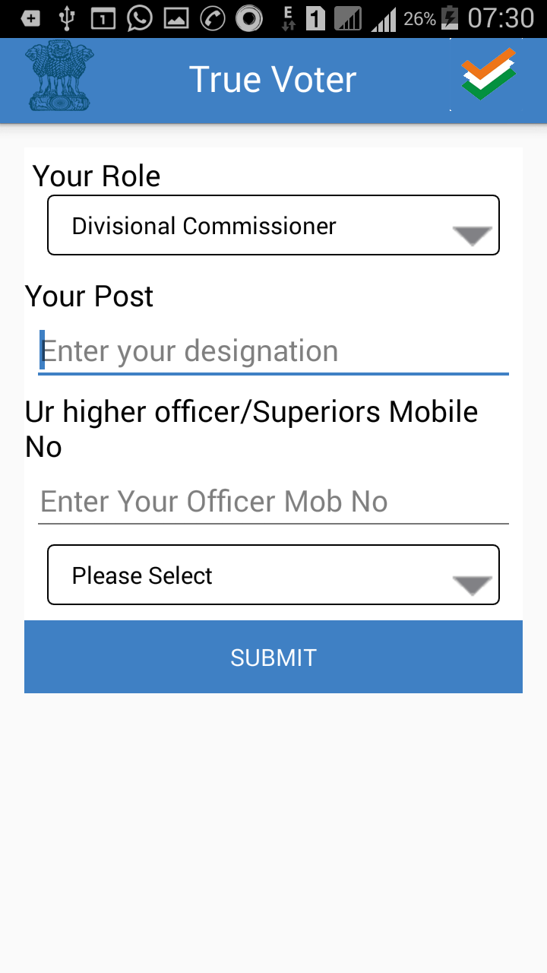
True Voter version 1.76
In side screen second page of registration is seen.
From SEC to Divisional Commissioner and his staff this screen will appear.
Select your proper role
Type your actual Official Designation in “Your Post” field.
Specifically a officer working as key person for the election should write as “Nodal Officer” in “Your Post” field.
Type your Superiors 10 digit mobile no at “Ur Higher Officer No.”
From last dropdown combo select the election type for which you are taking care.
Press “Submit” to finish the Registration Process

Slide 8
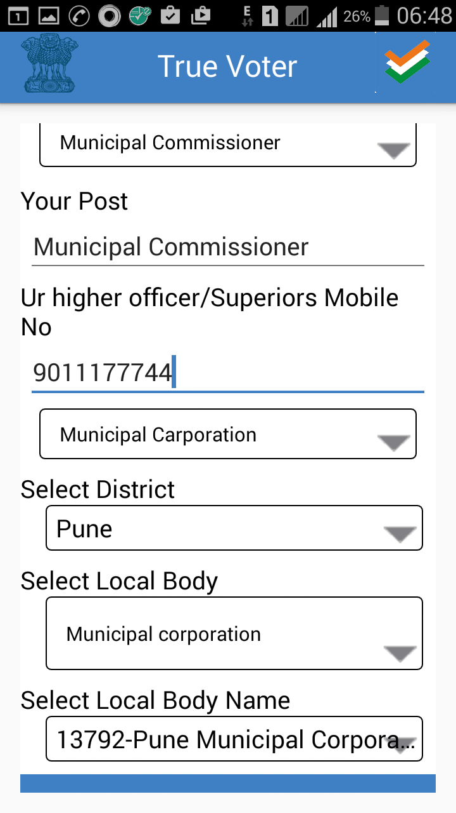
True Voter version 1.76
If you select role from Municipal Commissioner and onwards you have to provide specific local body to which you are related.
Type your post on which you are working. Nodal officer should specifically mention “Nodal Officer” post.
Type your Officer Mobile no under whom you are working.
Selection the election type for which you are working in election system.
Select District, Local Body type and Local Body name for which you are assigned responsibility.
Press “Submit” button to finish the registration process.
You will be taken back to first Home Screen. Use Login menu to go ahead.

Slide 9
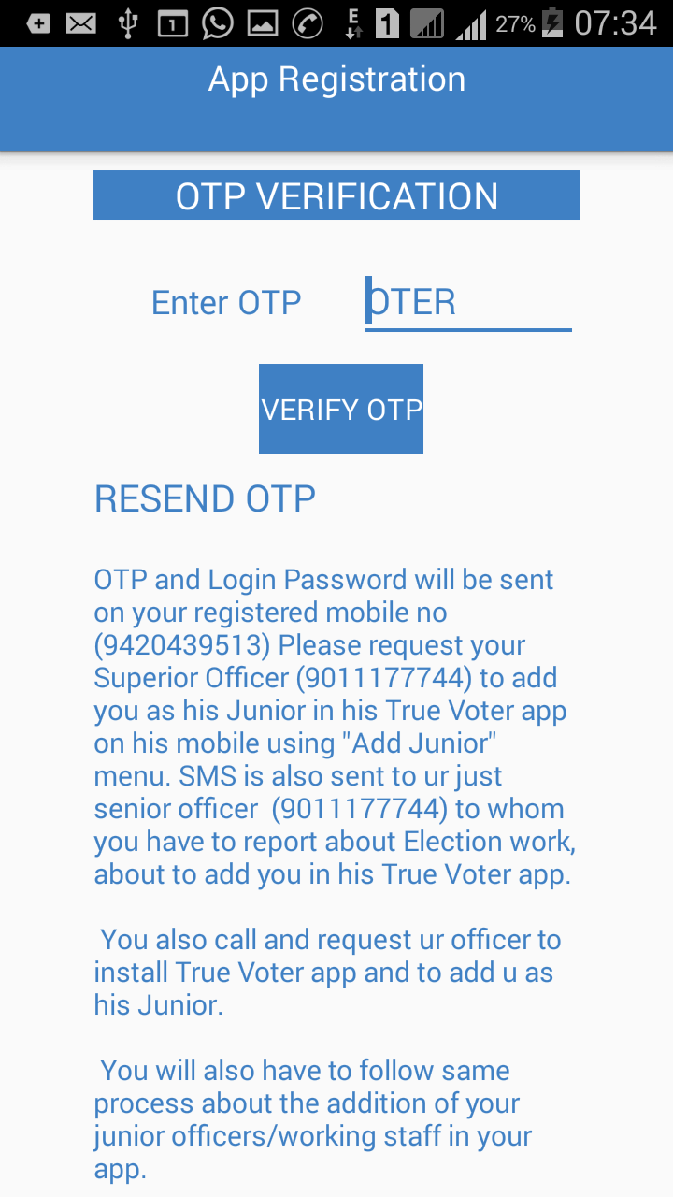
True Voter version 1.76
OTP Verification :
Licensing of app is device specific.
By sending OTP on your registered Mobile no and feeding it on the device in which you are installing app, relation between Mobile no and Mobile Handset is fixed. Change of handset is not allowed. You are going to get the user license for specific handset only. So be careful to install on the app on proper device. It is not transferable from device to device.
If you change the device then again OTP will be send to verify the change in handset.

Slide 10
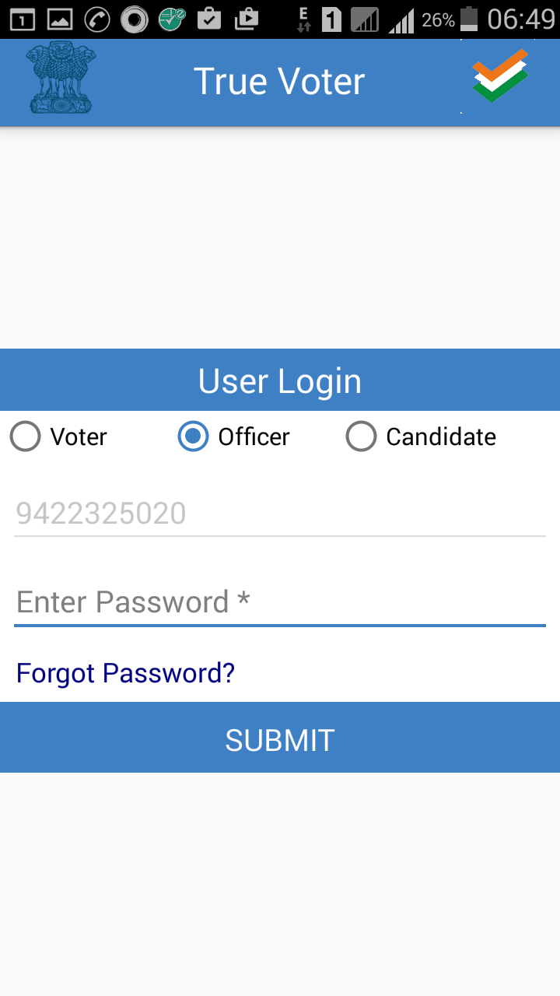
True Voter version 1.76
Login Menu :
There are three different types of login in True Voter App.
Voter login is based on Alpha Numeric user name, and it is not device dependant, as a voter you can login from any mobile any time.
Officer Login : It is for all Officers and Staff members related to on going election program. Its based on officers Mobile No and it is supposed to be used on his single unique fix handset
Candidate Login : It is for election contesting candidates and for their representatives. Its based on Candidate Mobile No and it is supposed to be used on his single unique fix handset. Login from multiple devices is not allowed.

Slide 11
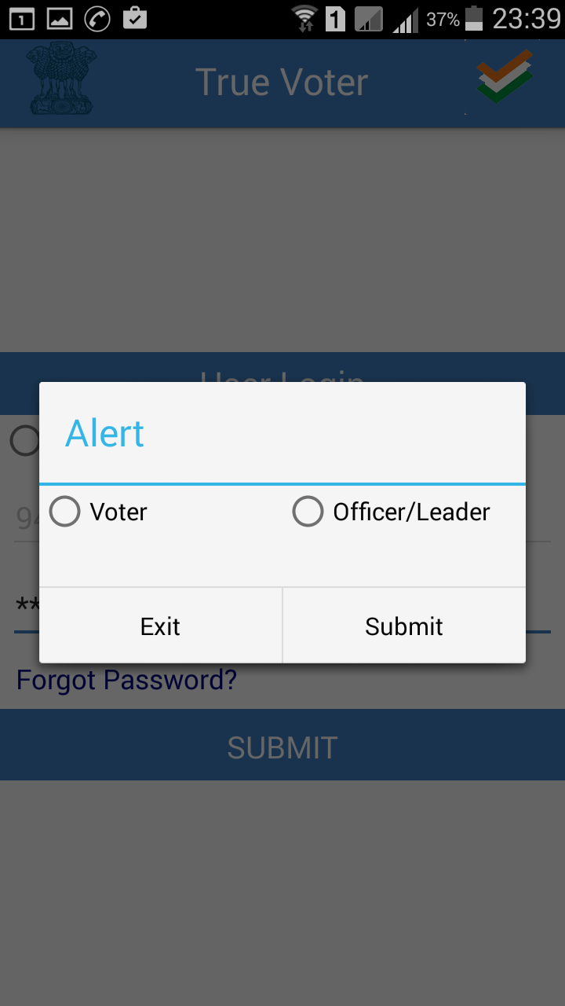
True Voter version 1.76
Forget Password :
If you forget password, you can recall on your registered mobile no.
As a voter your user name is alphanumeric, each user name is unique, it wont get repeated. More than one user name may be verified from same mobile no.
Officer and Leader registration depends on their mobile no and handset IMEI no, so one officer /leader is related to one mobile no only. They are not supposed to login various devices.
Click on Voter or Officer/Leader radio button to get the password of that role. And continue further pressing “Submit” button.

Slide 12
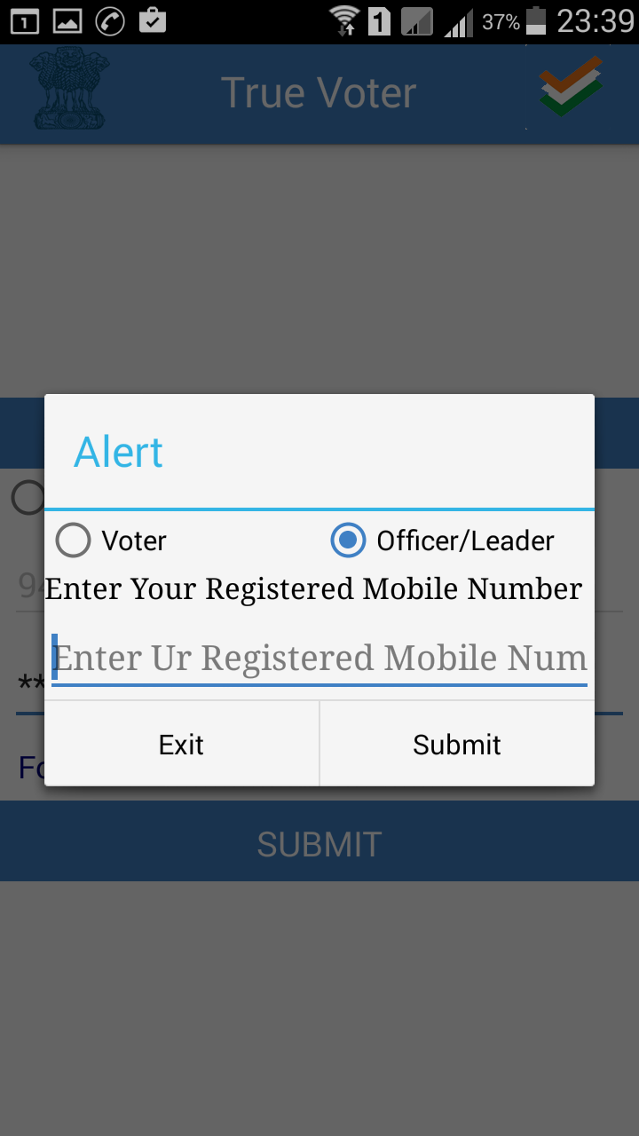
True Voter version 1.76
To Receive Password again :
To receive forgotten password in Officer/Leader role provide your registered 10 digit mobile no and press “Submit” to go ahead.
In Voter role you will have to provide user name and not a mobile no.

Slide 13
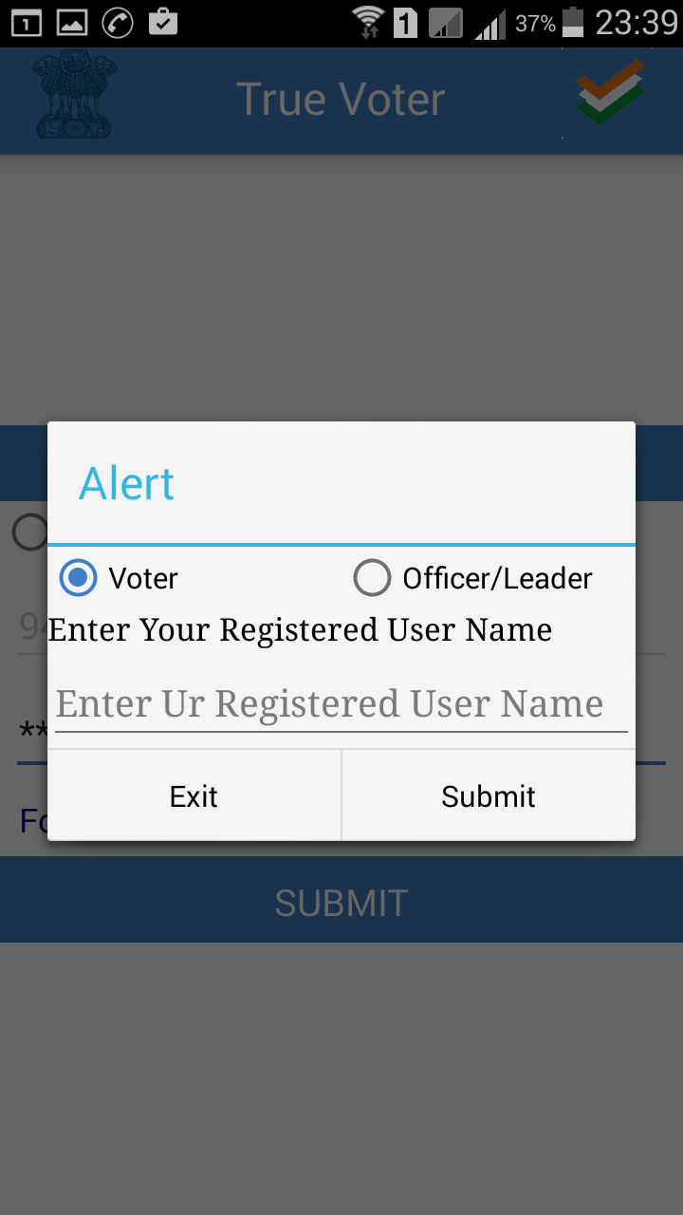
True Voter version 1.76
If you have forgotten password of your user name in voter role, use this option.
You will receive its password on your registered mobile no. it may be different than the handset on which you are using True Voter App.

Slide 14
True Voter version 1.76
If you register freshly True Voter app on your mobile then after registration you come back to main menu.
Click on Login icon to login.
If you have registered as a Officer or Candidate/ Representative then automatically your mobile no is locked as your user name, you have just to type password to go ahead, press “Submit” to continue. Net connection is must to login.
Here sample is of Officer registration, and screen of Officer login is shown.
It will take around 30 seconds to login. Notification about it will be displayed after pressing “Submit” button.

Slide 15
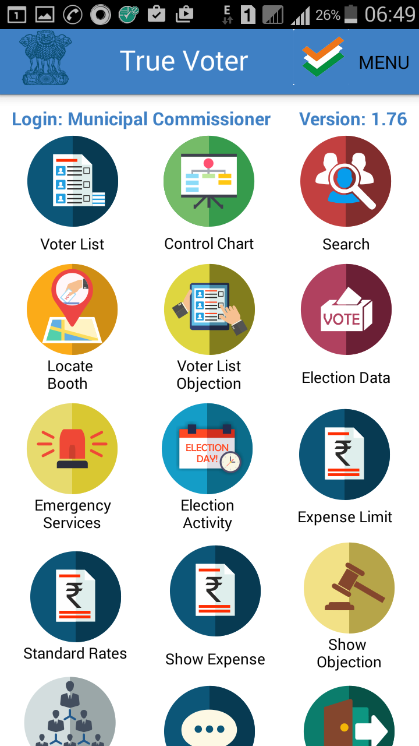
True Voter version 1.76
Officer Login Home Screen :
There are various icons on the home screen of Officer login. At the top your login role is displayed and version no of the app is also displayed at right corner.
If your role is wrongly selected then u logout and fill registration form again with proper role and information and login again.
Whenever you will exit the app, you will be still in the login state. When you will reopen the app you will come to this screen again. You have not to logout frequently. Be in login condition, as the app is on your own mobile.
1. Voter List, 2. Control Chart,
3. SEC Voter list search,
4. Locate booth, 5. Voter List Objection,
6. Election Data 7. Emergency Services
8. Election Activity 9. Expense Limit
10 Standard Rates 11 Show Expenses
12 Show Objection 13 Officers Tree
14 Feedback 15. Log Out.

Slide 16
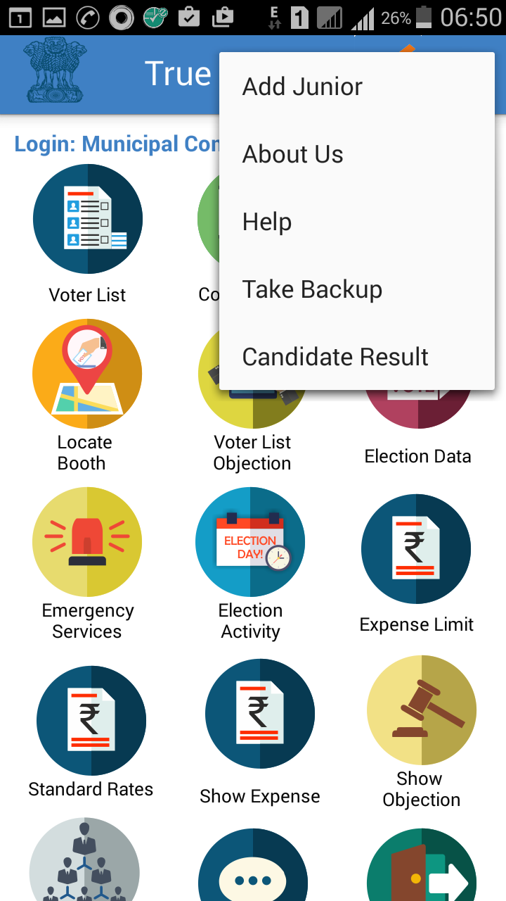
True Voter version 1.76
In upper side “Menu”
There are five options
1. Add Junior
2. About Us
3. Help
4. Take Backup
5. Candidate Result

Slide 17
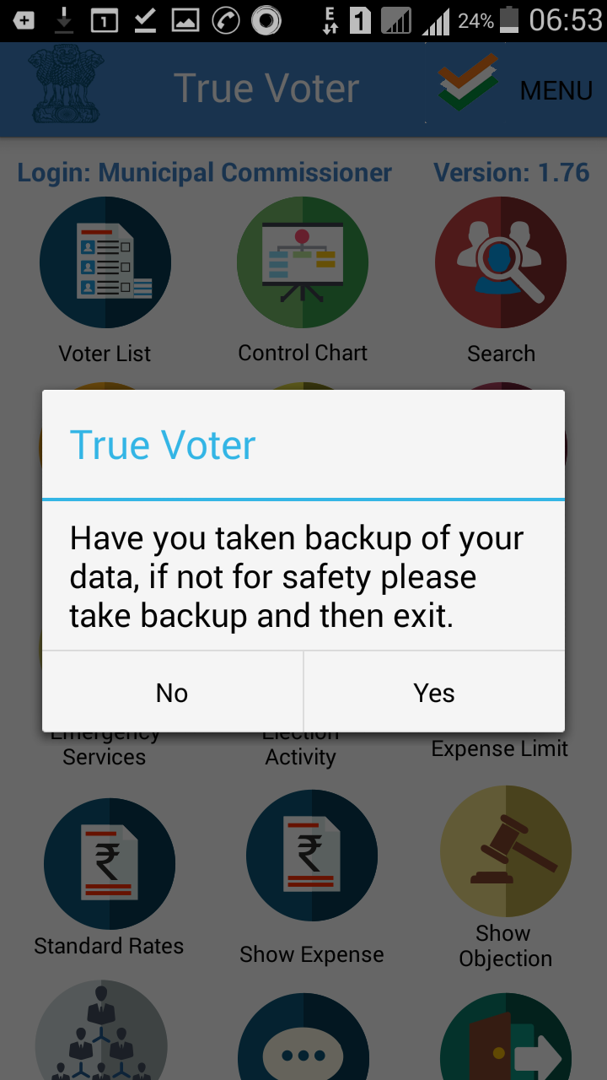
True Voter version 1.76
To Exit/Close App :
Don’t Logout
Be Logged In always.
Logout is to be used only when if your role is wrongly selected, when you are going to change the handset other wise there is no need to logout.
To close the app means to exit the app only press your mobile back button, you will get the message as shown in side window.
To protect your work done please take backup as and when you find it necessary.

